Slide 1

NHS Mental Health App
Empowering Gateshead with accessible mental health support
Presented by Team 9 – MY Software Walid | Jeremy | Cameron | Tony | Zaham | Haytham
Made by Walid

Slide 2
Meet the Team – MY Software (Team 9)
We all collaborated across multiple tasks to bring this app to life.
Jeremy | Project Lead / Art & Design
Cameron | Development Lead
Tony | Art & Design / Documentation
Haytham | Developer
Zaham | Marketing
Walid | Marketing Leader

Slide 3
Project Overview – What is the NHS Mental Health App?
A free mental health support app for Gateshead residents aged 16+
Developed in response to the NHS Mental Health Peer Support Team’s client brief
Includes tools like mood tracking, virtual pet care, gratitude journaling, and crisis support
Designed to be easy to use, with content suitable for an 8–10 year reading age
Available on web browsers and mobile devices

Slide 4
Client Requirements – What the NHS Asked For
A user-friendly, interactive app for ages 16+
Designed for a reading age of 8–10 years
Mood diaries, gratitude journals, and self-care tools Mindfulness, sleep, and resilience-building activities
Crisis support and links to NHS services
Works on both smartphones and web browsers
Easy to update and maintain after deployment

Slide 5
Live Demo

Slide 6
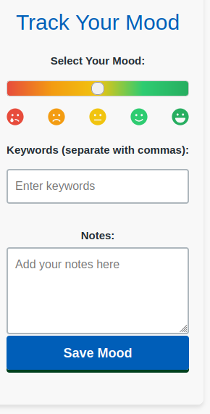
Feature Highlight – Mood Tracker
Log moods daily using emoji-style icons
Track emotional patterns over time with graphs
Receive personalized self-help article suggestions
Easy, one-click interface for fast logging

Slide 7
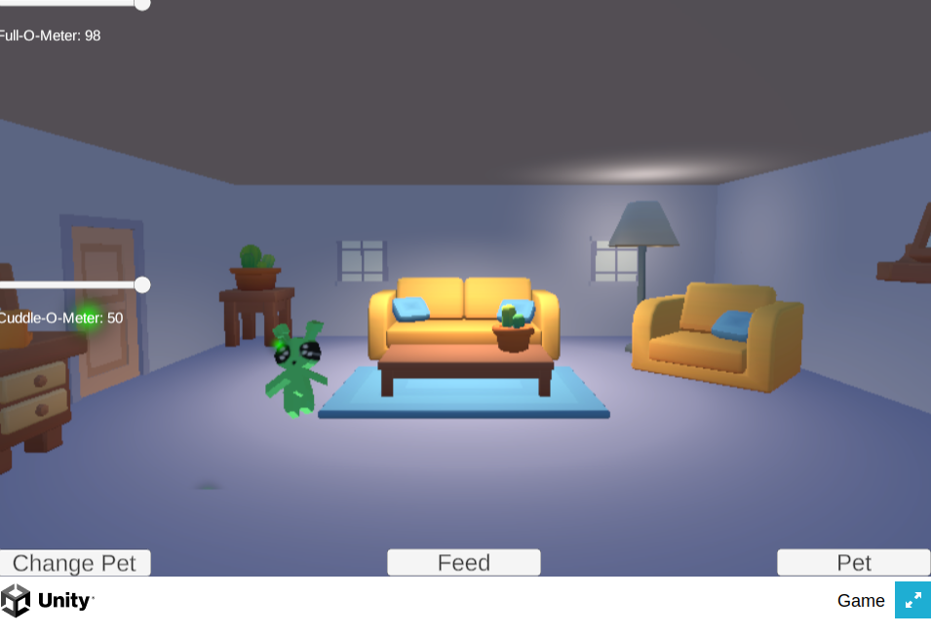
Feature Highlight – Virtual Pet for Mental Wellbeing
A Tamagotchi-style pet that users care for daily
Designed to reduce anxiety through routine and interaction
Pet’s mood reflects user engagement and emotional state
Rewards system encourages positive self-care habits

Slide 8
Feature Highlight – Self-Care & Crisis Tools
Screenshot of recommended ressources of the app
Access gratitude journals, breathing exercises, mindfulness
Weekly mental health articles for education and self-awareness
Quick crisis support button with links to NHS helplines
Tools available 24/7 — especially for moments of stress or anxiety

Slide 9
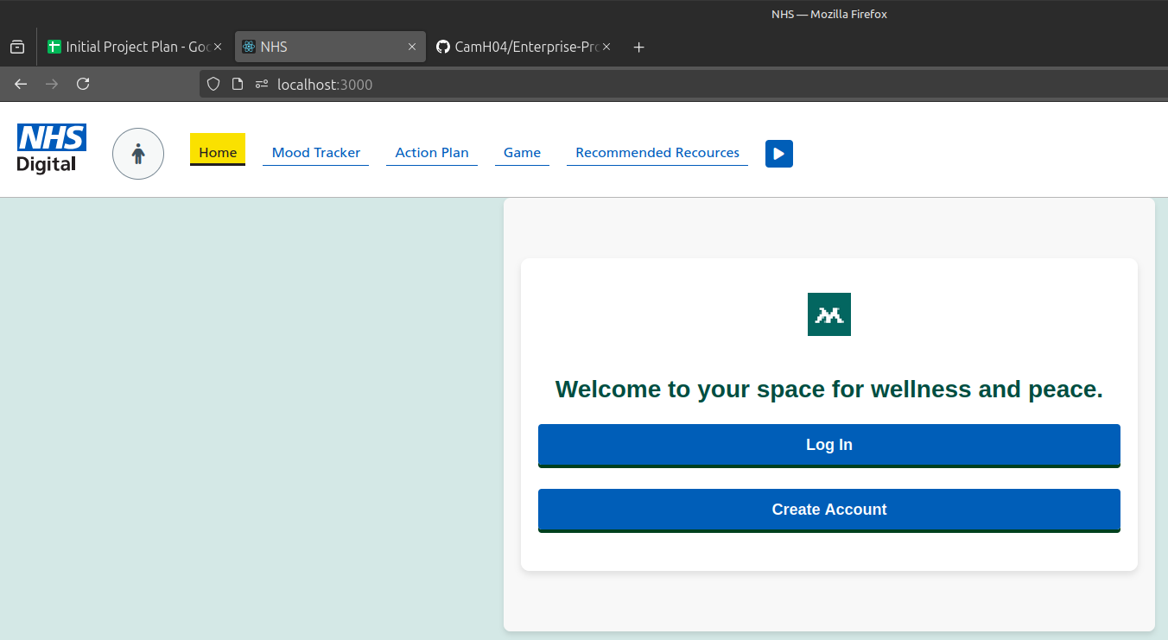
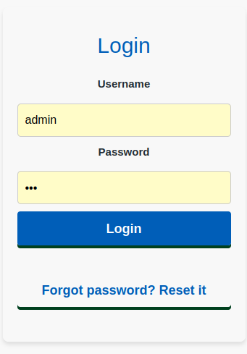
Technical Feature – Login & Data Handling
Secure login system with username & password
Built with React (frontend), ExpressJS (backend), and SQLite (database)
Stores user mood entries, pet progress, and journal data
Hosted locally or can be deployed to a secure server
Ensures data privacy and reliability

Slide 10
Design & Accessibility Approach
Add a visual mockup of the homepage or pet feature with annotations showing these design choices.
Calming blue and green color palette to support emotional comfort
Simple fonts and large buttons for ease of reading (suitable for 8–10 year reading age)
Minimalist layout to avoid user overwhelm
Fully mobile-optimized and responsive for all screen sizes
Icons and visuals used to replace complex text when possible

Slide 11
Marketing Approach

Slide 12
Marketing Strategy – No Budget, Big Reach
https://mysoftwaresun.netlify.app/
Social Media Campaigns
Community Engagement
Referral System
Blog & SEO

Slide 13
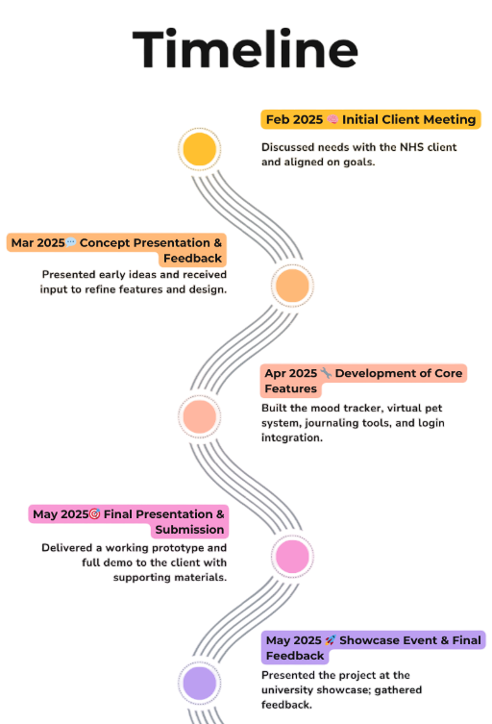

Slide 14
Any questions or feedback? Thank you for your time! We hope this app makes a difference.
Team 9

